Slide 1
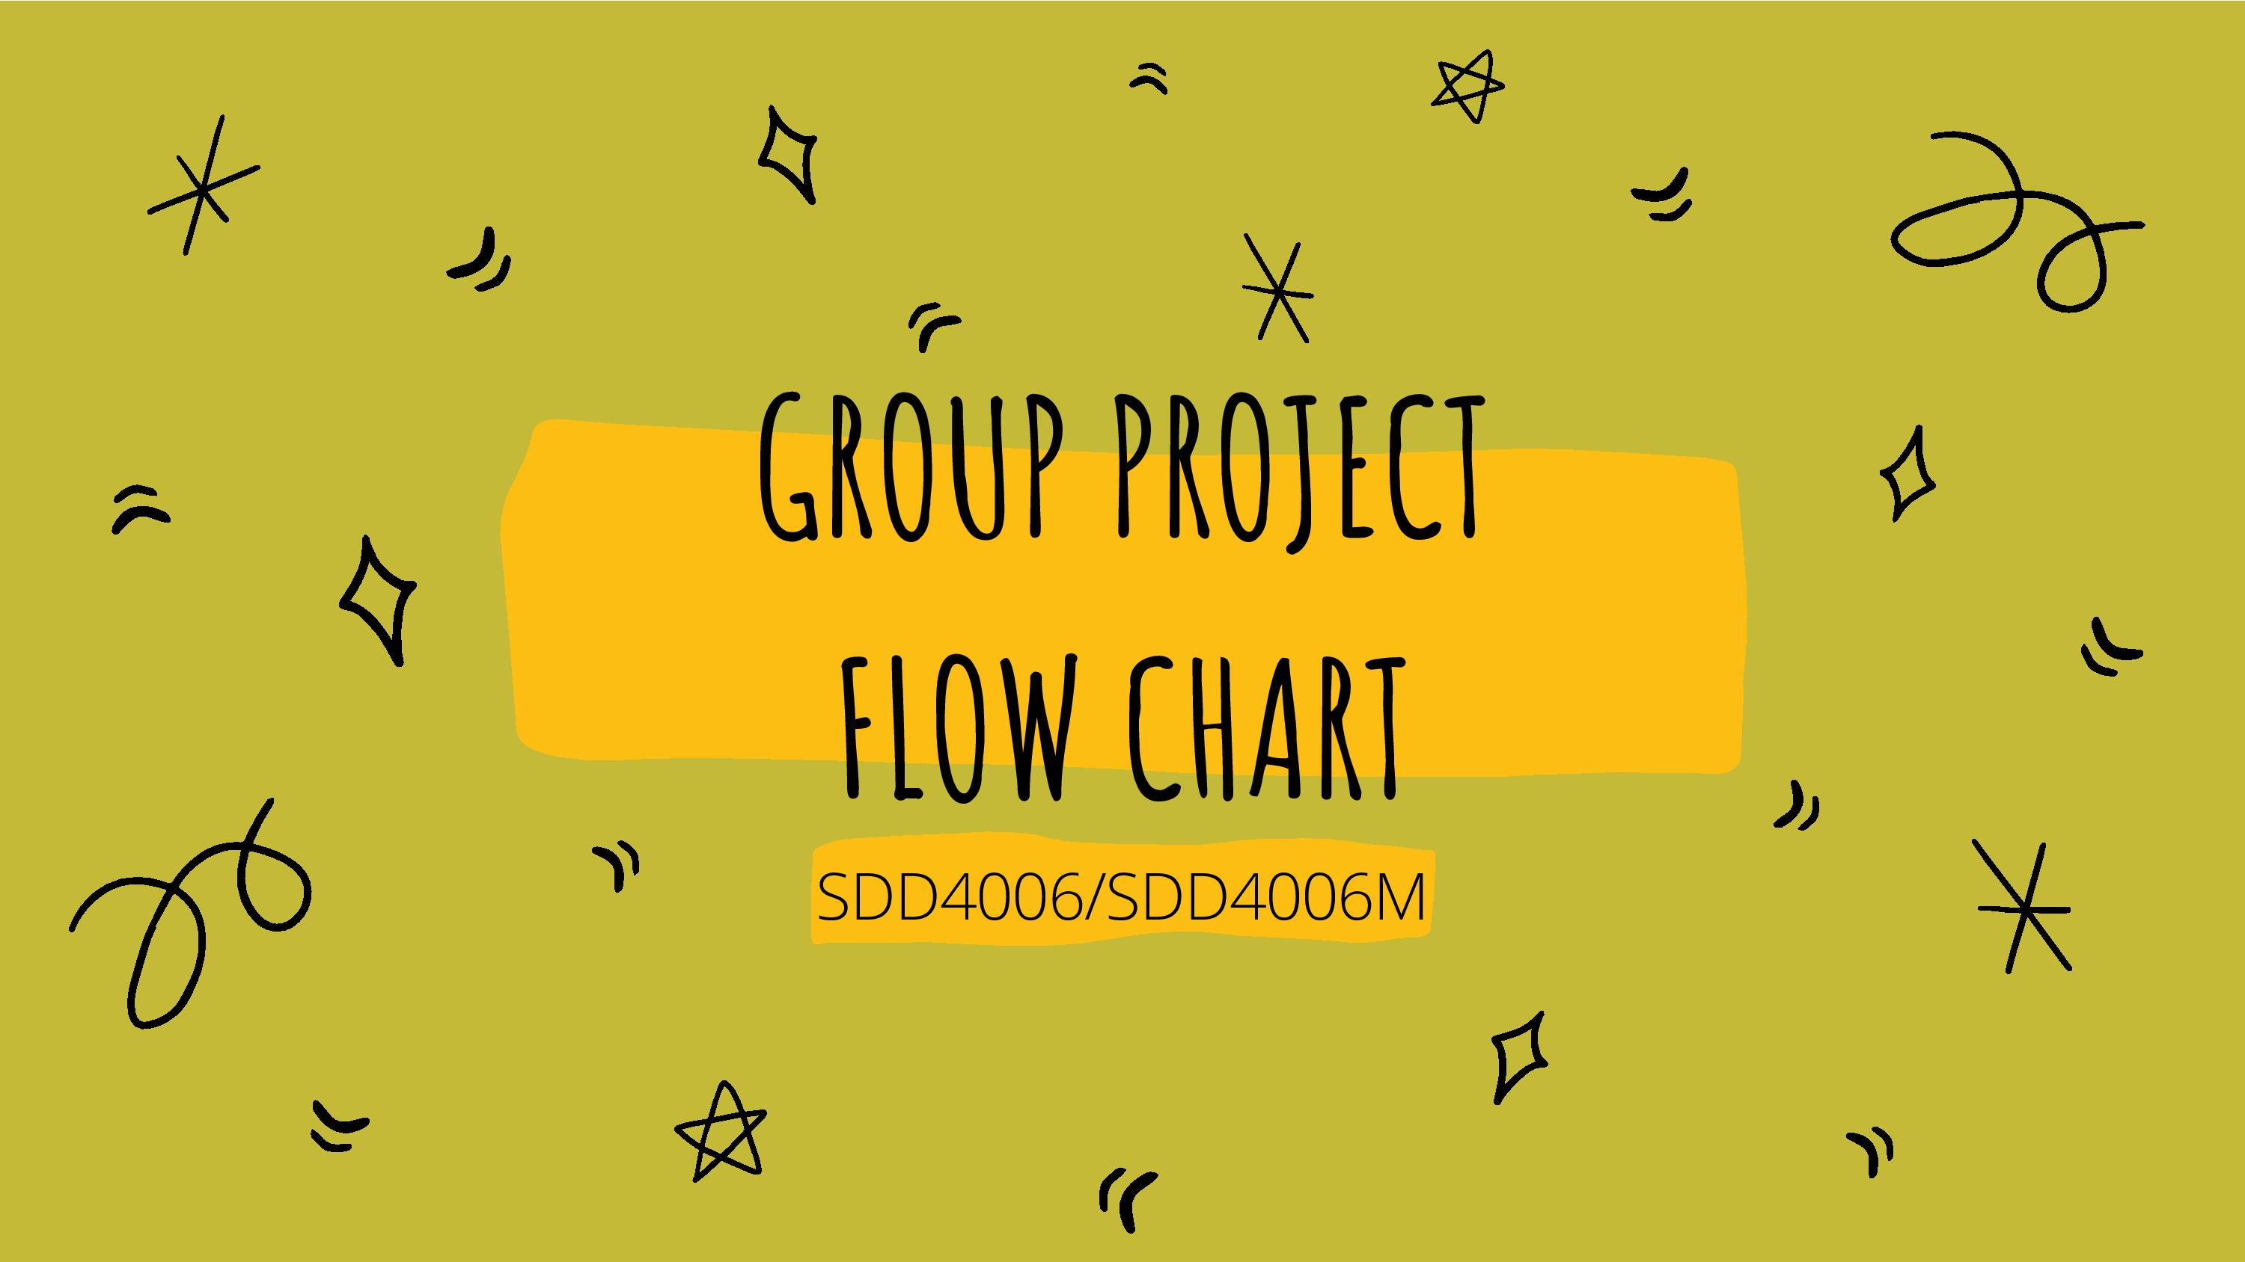

Slide 2

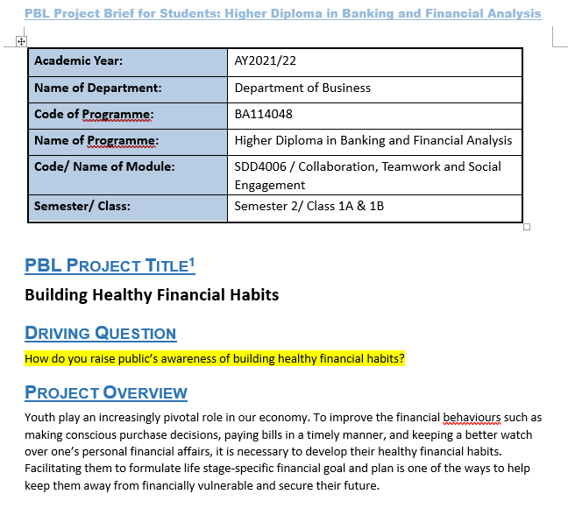
Notes:
Teacher please introduce related project brief (student version) and explain the driving question to student.
The photo of project brief is subject to change by teacher

Slide 3
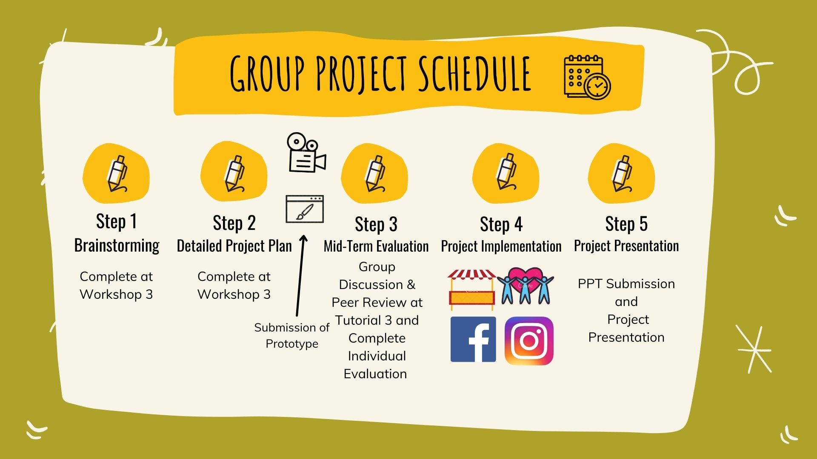
Project-based Learning (PBL)
Introduction of Project Brief
Notes:
Teacher can ask students to fill in the appropriate dates.

Slide 4
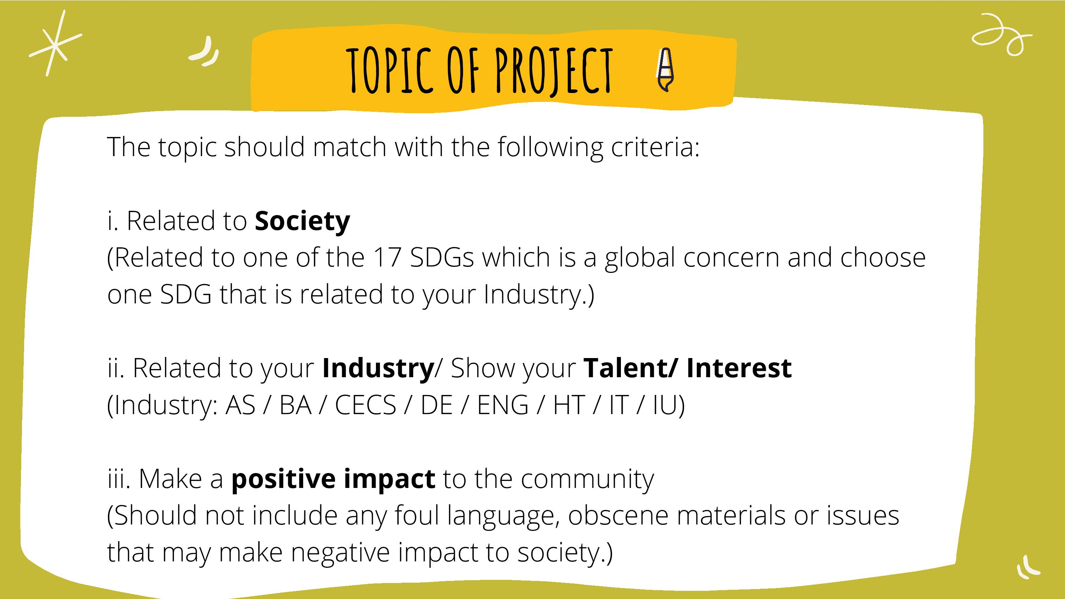

Slide 5

Format & Steps of Project
Video shooting (At least 3-min) e.g. simple animation, stop motion, drawings, comics creation | Suggested Steps Idea → Storyboard → Shooting → Editing → Design questionnaire (related to outcomes) → Promote the video via social media, e.g. Facebook / Instagram / YouTube → Collect feedback by questionnaire → Analyze the result of questionnaire
Online activity - Live (At least 1-hour) e.g. online talk / music performance / interest class to classmates / interview with guest | Suggested Steps Idea → Content & Rundown → Scripts & rehearsal → Design questionnaire (related to outcomes) → Promote the activity via social media, e.g. Facebook / Instagram / YouTube / Myportal → Live broadcast through MS Teams / Facebook etc. → Collect feedback by questionnaire → Analyze the result of questionnaire
Telephone / Online volunteer service (At least 1-hour) e.g. elderly service via telephone contact, online drawing class for deprived children | Suggested Steps Contact with NGOs → Discuss the content & work flow → Design questionnaire (related to outcomes) → Promote the service via NGOs → Services → Collect feedback by questionnaire → Analyze the result of questionnaire
Competition / Proposal presentation | Suggested Steps Idea → Research, e.g. online survey, telephone interview → Content & Rundown → Prepare the proposal → Scripts & rehearsal → Presentation to the organizer / industry → Collect feedback from organizer / industry
Booth (At least 2-hour) | Suggested Steps Idea → Content & Rundown → Rehearsal → Design questionnaire (related to outcomes) → Promote the Booth via social media, e.g. Facebook / Instagram / YouTube → Booth operation → Collect feedback by questionnaire → Analyze the result of questionnaire
Face-to-Face Volunteer service (At least 1-hour) | Suggested Steps Contact with NGOs → Discuss the content & workflow → → Design questionnaire (related to outcomes) → Promote the service via NGOs → Service → Collect feedback from NGO / users by questionnaire → Analyze the result of questionnaire
Notes:
*Teacher could select the appropriate formats for students’ selection.

Slide 6
Resources for Reference
Video shooting (At least 3-min) e.g. simple animation, stop motion, drawings, comics creation | Suggested Video Production Tools / How to make simple videos? www.canva.com https://www.animaker.com/ https://www.powtoon.com/homepage/ https://m21.hk/boundlessclassroom/ https://www.doodly.com/onetime/offer-fb-broad.php https://www.toonly.com/special-one-time-price-fb.php
Website | Suggested Website Production Tools: Free Website Builder | Create a Free Website | Wix.com https://www.sites.google.com
Notes:
*Teacher could select the appropriate formats for students’ selection.

Slide 7
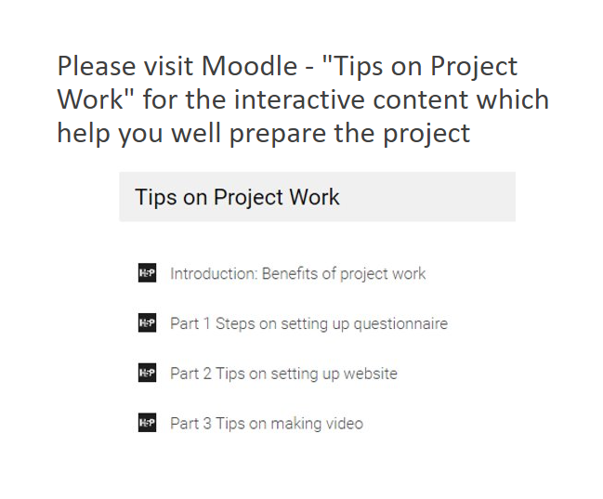
Add H5P

Slide 8


Slide 9
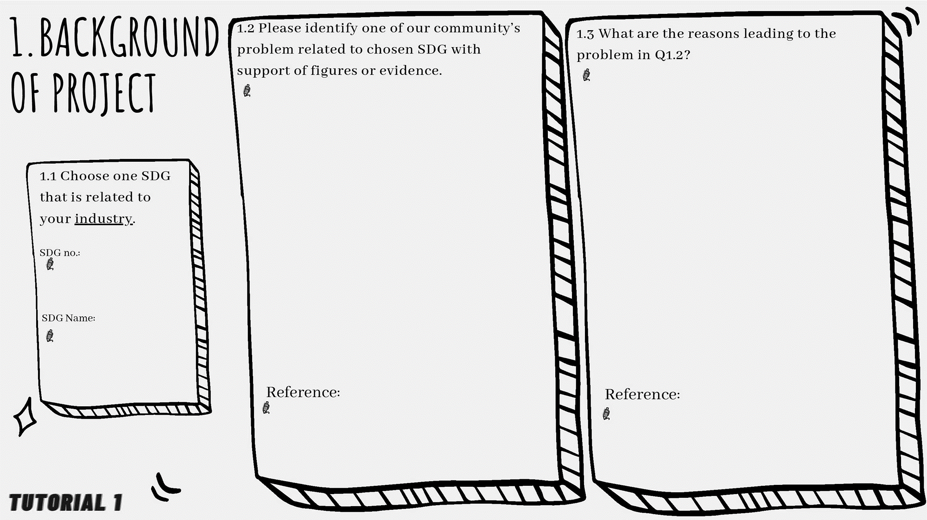
POINTS:
SDG: RISK MANAGEMENT
NEW & Evolving standards
WHY?
New / Mounting Standards
STANDARDS ARE EVOVLING
New & evolving security breaches
REGULATIONS ARE MOUNTING
Problems
IDENTITY & ACCESS
UNEDUCATED – TEENS / YOUNG KIDS LEKAING Personal or others data.
Targeted for scamming
Huge amount of time on the internet
SDG. 9
INDUSTIRY, INOVATION & INFRASTRUCTURE
Notes:
1.1 請填上所選的SDG號碼及名稱。 (該SDG可以是你的行業引起的社區問題, 或是運用你的行業知識去改善的可持續發展目標)
1.1 SDG related to your industry : It can be a problem of that SDG caused by your industry OR using your industry knowledge to solve a SDG problem / achieve a SDG.
1.2 請寫出其中一個社區/人類面對的問題, 需要乎合所選的SDG, 並列舉有關問題的數據或證據(例子)。
並在參考(Reference)欄上寫下資料來源。
1.3 承上題, 請寫出該問題的成因，然後參考(Reference)欄上寫下資料來源。

Slide 10
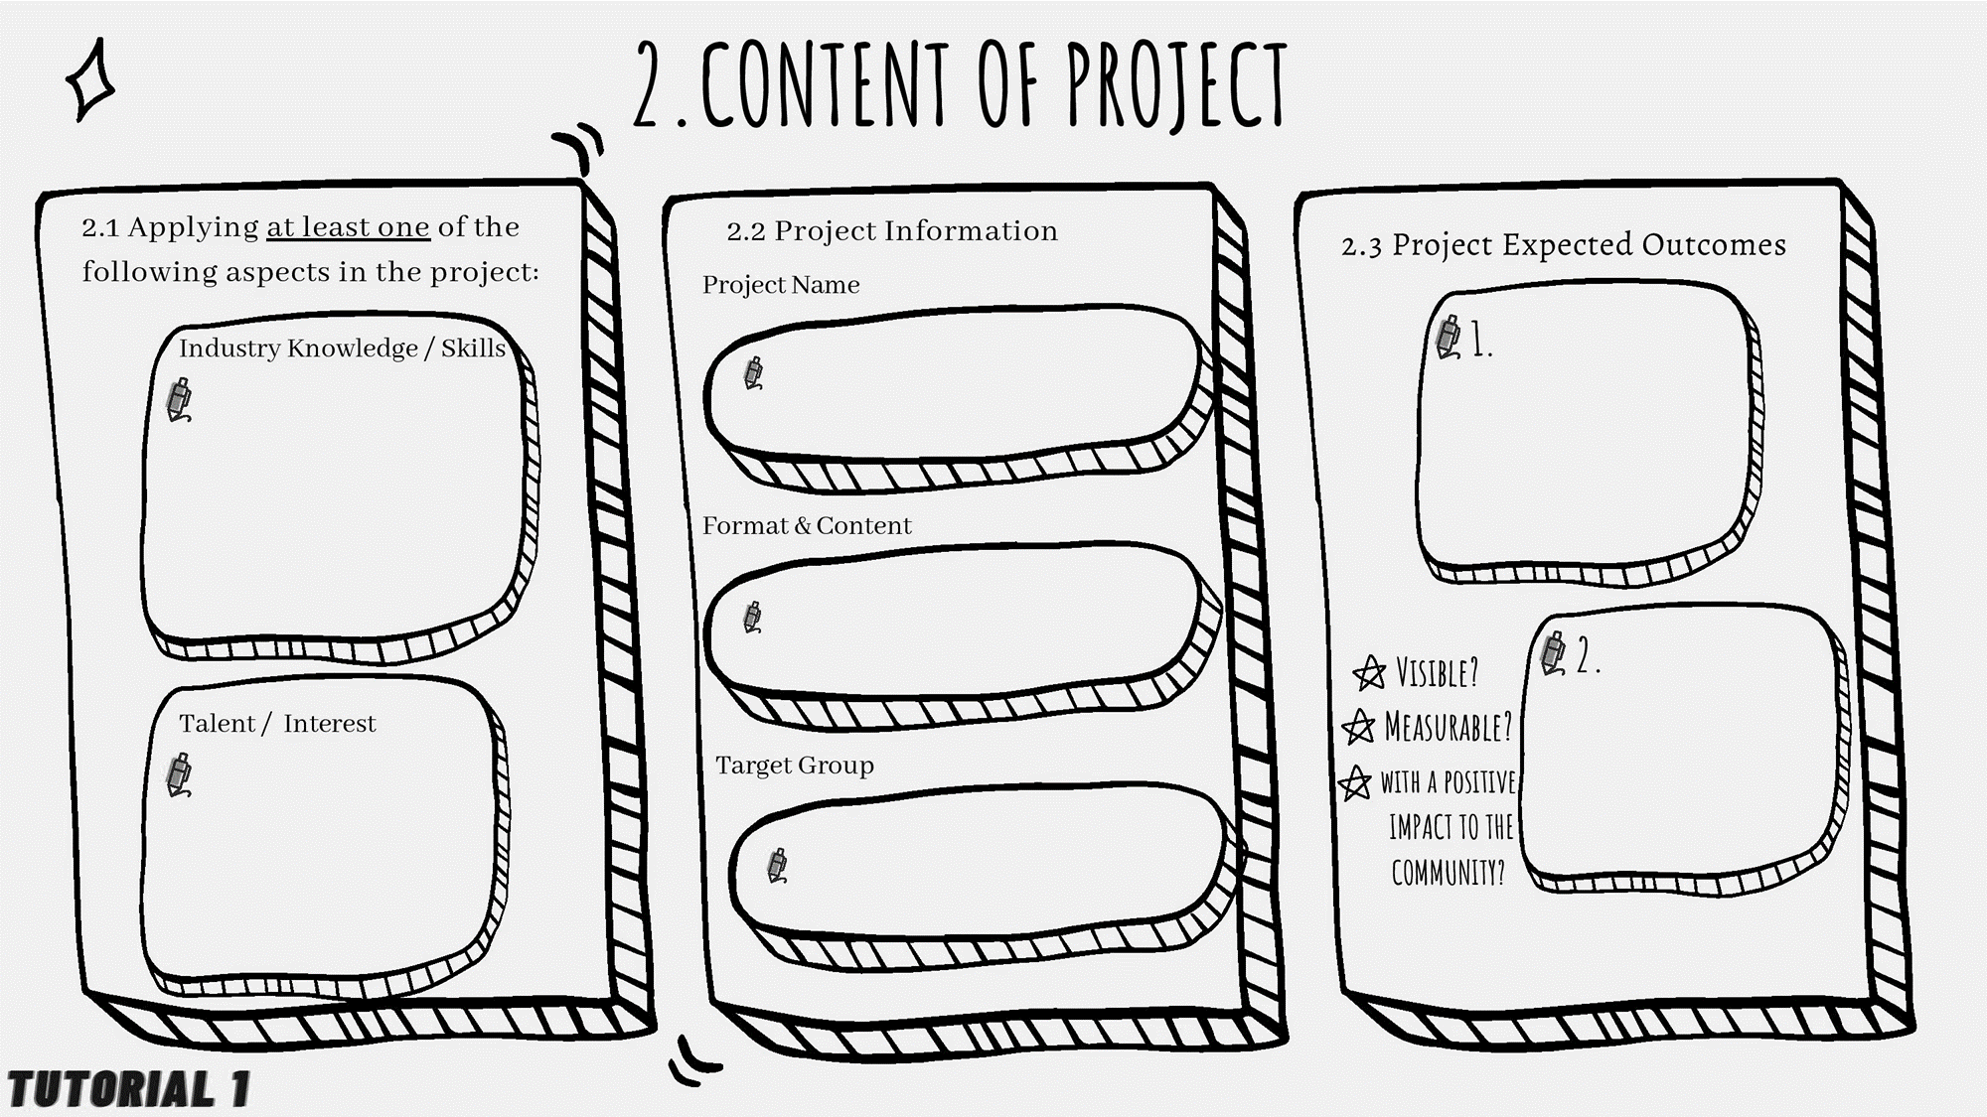
Expand Cybersecurity Knowledge
Project Bootstrap
Network Security
Risk Management
Make sure they understand the Risk & Information
Problem solving
Intelligence
Scripting
Workshop for kids 8 -16 years old
Increase Awareness on Cyber-Security
Hosting Website
Website Building
Young Kids
Teenagers
Notes:
2.1 請應用以下最少一樣的方向到你們將要設計的計劃。
行業知識/技能
你或你小組成員擁有的才能/興趣
2.2 請寫出小組計劃的名稱、形式及對象。
2.3 請寫出計的兩個預期成果, 需要是看得見, 可量度 及 為社區帶來正面的影響。
Should be visible, measurable & with positive impact to the community

Slide 11
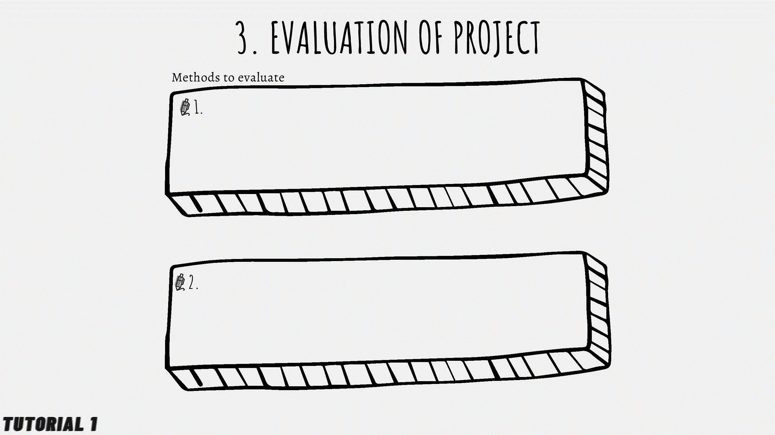
Questionnaire
Forms
Mini-game
CTF (Capture The Flag) challenge
Interactive Phishing Labs
Viewers-->X click
-->use/try "fishing" skills
Notes:
請列出兩個評估project成果的方法 (如: 問卷調查, 觀察, 對象分享…等)

Slide 12


Slide 13

Date | Time | Task | Venue / Platform | Responsible Member(s) | Resources needed (if any)
9/2/2023 - 2/3/2023 | 1 Month | Website design & implementation Frontend / Backend Workflow Management | N/A | Tang Cheuk Hei | N/A
9/2/2023 - 27/2/2023 | 2 weeks | PowerPoint Design / workflow management Presentation workflow management Prototype UI/UX Design Storyboard UI/UX Study | Figma Adobe XD Notion | Mercado John Kenneth De Leon Hung Yat Shan Tang Cheuk Hei | N/A
9/2/2023 - 2/3/2023 | 1 Month | Digital Questionnaire Data analyst Data Collection Data Study Final Data Study | Google | Dong Siu Him Ng Wing Yin Ko Chun Kit | N/A
Notes:
Date & Time (日期及時間)
Task (任務): E.g. Search information, Set up IG/Website or Video Shooting/Editing, Set and Analyze Questionnaire, Promotion of IG/Website, EA Group Presentation PPT)
Venue / Platform (地點/平台) E.g. Wix.com / sites.google.com / Youtube / IG / Google Form
Responsible Member(s) (負責的組員英文全名 English Full Name, 某些困難任務可多於一人負責)
Resources needed (if any) (所需物資)
Tang Cheuk Hei
Dong Siu Him
Ng wing Yin
Ko Chun Kit
Hung Yat Shan
Mercado J.k De Leon

Slide 14
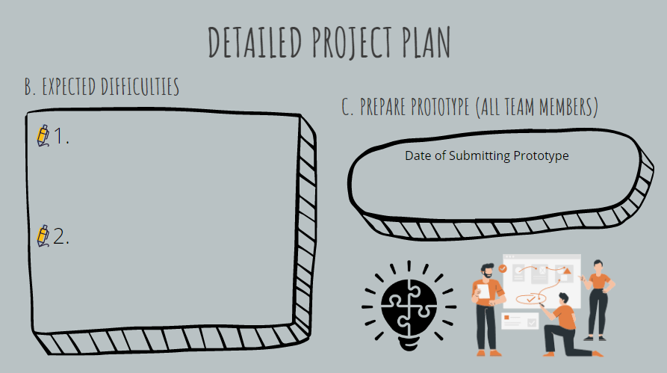
The website could be blocked due to against Terms of Service (ToS)
13 April, 2023
Not enough time to fully complete the website
Notes:
B. Expected Difficulties 1, 2 (寫出在籌備過程/活動當天，兩個可能會出現的困難)
C. Prepare Prototype (All team members) 所有隊員一同創作Prototype
Date of Submitting Prototype: 請向老師查詢
*Students have to submit prototype such as Website or IG outline / video story board / drafted questionnaire / drafted activity rundown / video clips / drafted IG or website etc. to teacher before Step 3 (Mid-term Evaluation).
*同學需於Step 3 (Mid-term Evaluation)之前, 提交Project半製成品(如: 網頁或IG大綱 / 短片大綱 / 問卷初稿 / 活動流程 / 零碎短片 / 網頁初稿等)

Slide 15

Examples
Notes:
Students have to submit prototype such as story board / drafted questionnaire / drafted activity rundown / video clips / drafted website to teacher before Step 3 (Mid-term Evaluation).
同學需於Step 3 (Mid-term Evaluation)之前, 提交Project半製成品(如: 短片大綱 / 問卷初稿 / 活動流程 / 零碎短片 / 網頁初稿等)

Slide 16





Why prototype (半製成品) ?
a first model or sample of a product
built as models to test a product concept or process or to act as an example to be replicated or learned from.
The benefits and why you should have a prototype:
The ability to run quickly through multiple design concepts and corrections
Fewer production design flaws and better end-products
Fast and effective communication of design ideas
Effective validation of design fit, form, and function
https://product-design-prototype-experts.com/why-a-prototype/
Notes:
https://product-design-prototype-experts.com/why-a-prototype/

Slide 17

Show the design of your end product
Explain your ideas
Propose some questions for the survey to target group
Examples of prototype:
End product | Prototype
Movie/ video | story board, script
Workshop | Workshop rundown
IG/ Website | Draft content, interface design, layout
Wooden work/ Artwork, etc. | Model, Sketch
Exhibition | Booth design

Slide 18
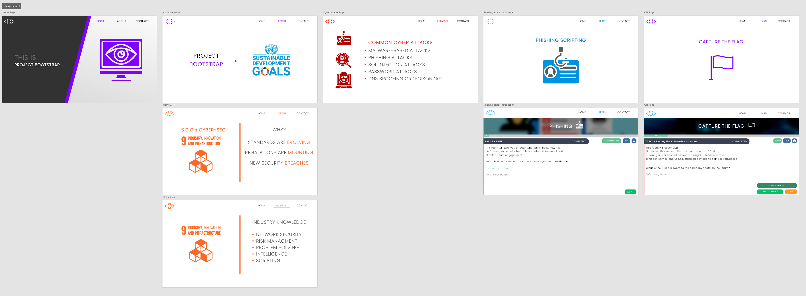
Web page prototype
Layout
A high-level overview of the web page:

Slide 19
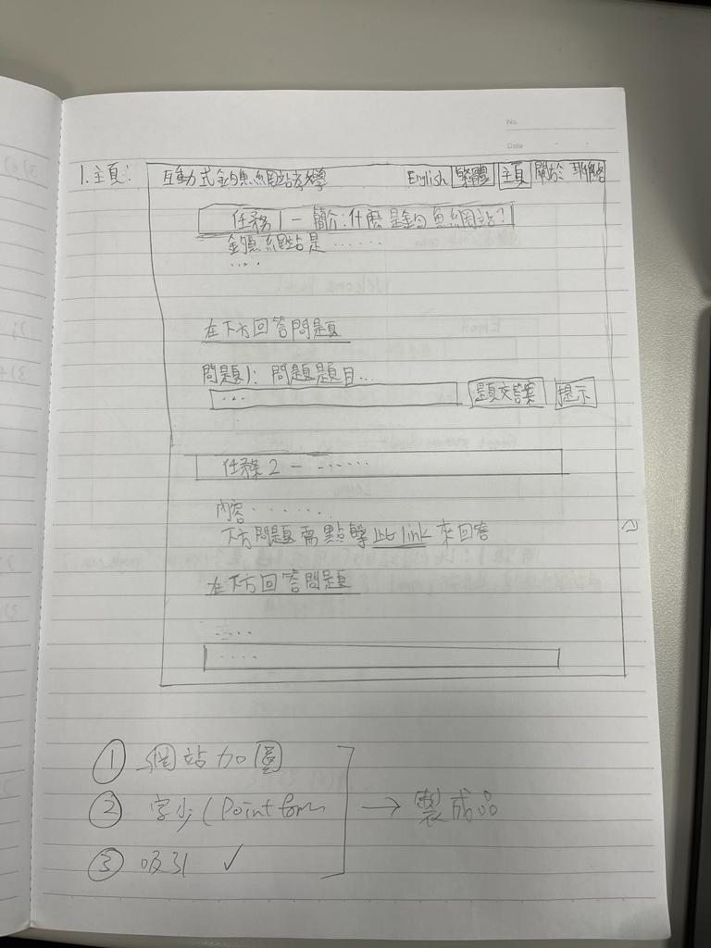
Web page prototype
Draft content
The home page of the website ==>
Users can learn more about phishing attacks by playing an interactive lab

Slide 20
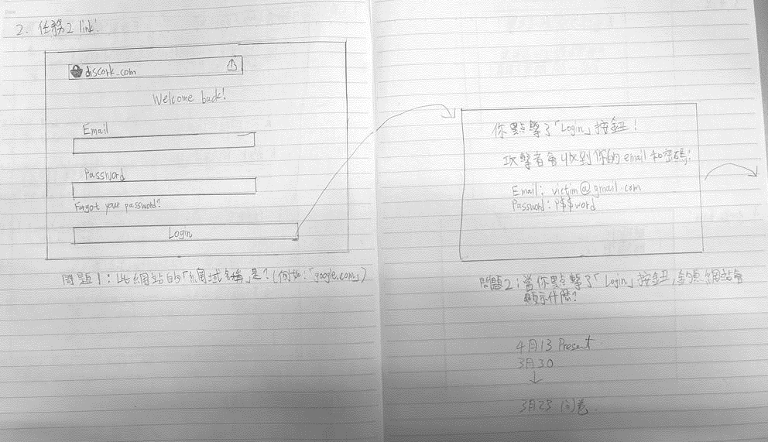
Web page prototype
Draft content
In the lab, users can play a fake interactive phishing lab, and show the consequences of getting phished:

Slide 21
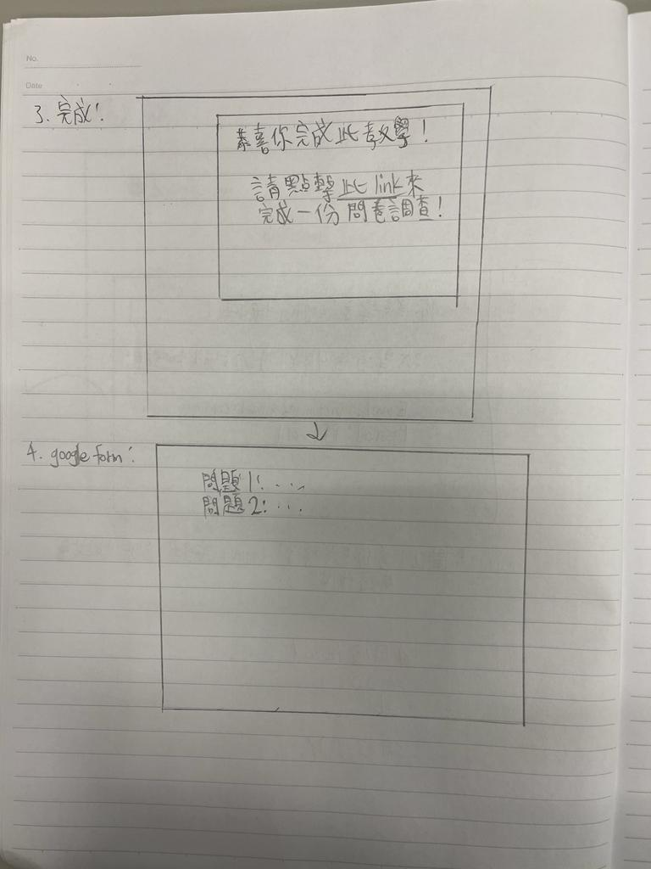
Web page prototype
Draft content
When the user answered all questions, they'll be prompt to an alert box, which will then completing a survey:

Slide 22
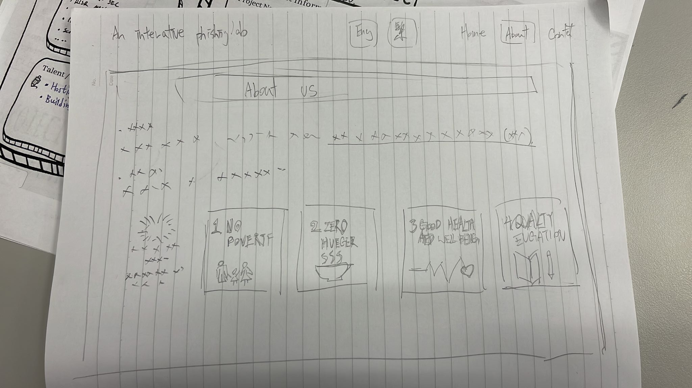
Web page prototype
Interface design
The "About us" page shows the project aim, expected outcome, and source code of the website.

Slide 23
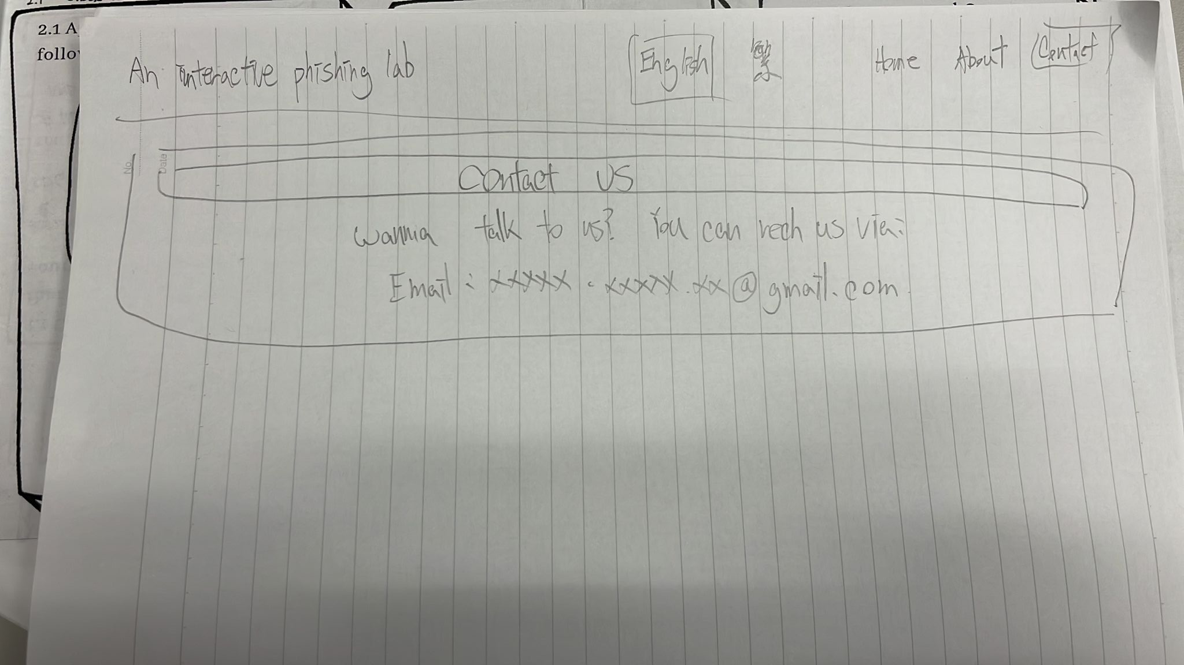
Web page prototype
Interface design
The "Contact us" page will show how visitors can reach out to us.

Slide 24

Notes:
To be completed during Tutorial 3

Slide 25
Team Role of each member
Teammate Name | Team Role | Task he/she in charge
Tang Cheuk Hei | Leader | Website design & implementation
Dong Siu Him | Teammate | Google form & PowerPoint
Ng Wing Yin | Teammate | Google form & PowerPoint
Ko Chun Kit | Teammate | Google form & PowerPoint
Hung Yat Shan | Teammate | Google form & PowerPoint
Mercado J.k De Leon | Teammate | Website design & implementation

Slide 26
How was your group’s performance in terms of the following collaboration skill(s)?
(Please edit the radar graph below to show your group’s performance)

Slide 27
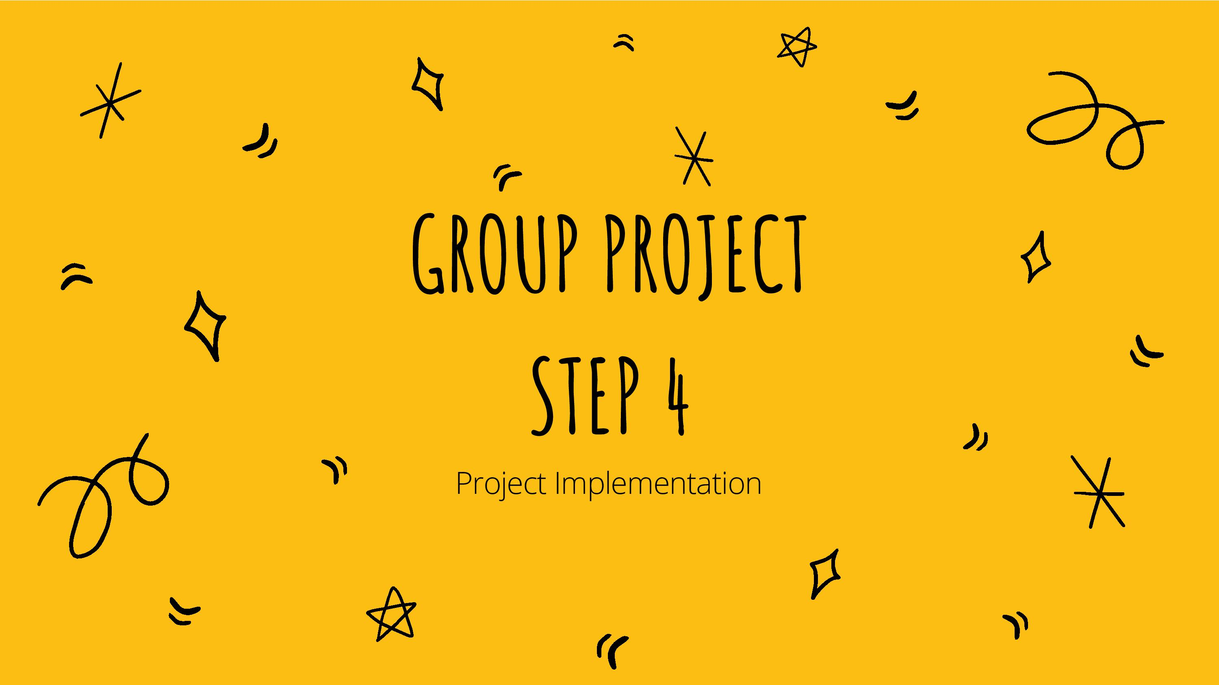
Notes:
E.g. implement the service, release promotional video or website, collect feedback from participants or viewers, analyze the result of questionnaire. And prepare EA Project Presentation.
例如: 進行義工服務、發放短片或網頁、收集/分析問卷等 ; 及預備EA匯報

Slide 28


Slide 29


Slide 30
SDD4006/SDD4006M Project Presentation
Programme Code/Class: IT114122/1C
Programme Title: Higher Diploma in Cybersecurity
Group No. 3
Project Topic: How young people can learn from cyberattacks and develop good practices in cybersecurity
Group Members:
1. Tang Cheuk Hei/ 220006482
2. Dong Siu Him/ 220371854
3. Ng Wing Yin/ 220018235
4. Ko Chun Kit/ 220111510
5. Hung Yat Shan/ 220220462
6. Mercado J.k De Leon/ 220017982

Slide 31
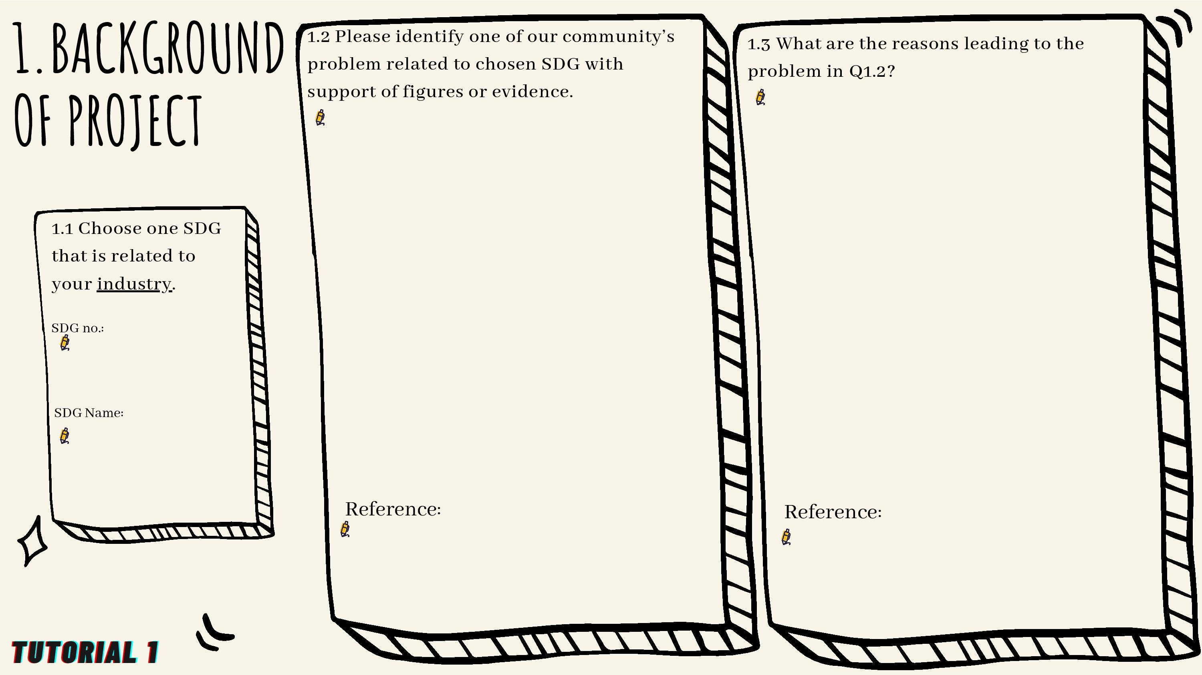
SDG: RISK MANAGEMENT
NEW & Evolving standards
WHY?
New / Mounting Standards
STANDARDS ARE EVOVLING
New & evolving security breaches
REGULATIONS ARE MOUNTING
Problems
IDENTITY & ACCESS
UNEDUCATED – TEENS / YOUNG KIDS LEKAING Personal or others data.
Targeted for scamming
Huge amount of time on the internet
SDG. 9
INDUSTIRY, INOVATION & INFRASTRUCTURE
Notes:
1.1 請填上所選的SDG號碼及名稱。 (該SDG可以是你的行業引起的社區問題, 或是 運用你的行業知識去改善的可持續發展目標)
1.1 SDG related to your industry : It can be a problem of that SDG caused by your industry OR using your industry knowledge to solve a SDG problem / achieve a SDG.
1.2 請寫出其中一個社區/人類面對的問題, 需要乎合所選的SDG, 並列舉有關問題的數據或證據(例子)。
並在參考(Reference)欄上寫下資料來源。
1.3 承上題, 請寫出該問題的成因，然後參考(Reference)欄上寫下資料來源。

Slide 32
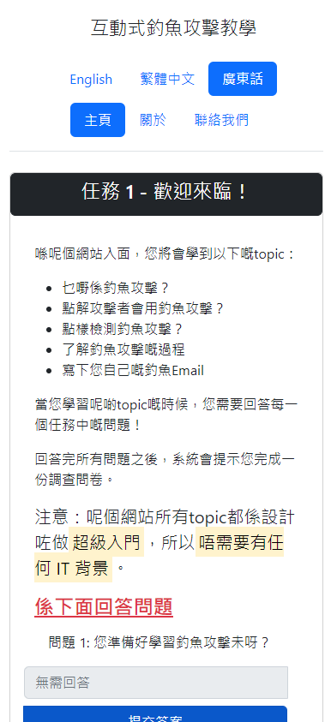
After completing the Project…
2. Content of the project
2.1 What have your group done finally in the project?
Photo if available
(highly recommend)
Date: 9/2/2023 – 27/3/2023
Time: 46 days
Location/Platform: Website
Format (e.g. online workshop / video) & Content: Online workshop
No. of participants / Hit rate / No. of views: 50 questionnaire responses, 12 completed lab
Link of the project (if any):
https://phishing-lab.infinityfreeapp.com
Notes:
Content of the project 項目內容
2.1 What have your group done finally in the project? 你小組的項目最後完成了什麼工作?
Date日期:
Time時間:
Location/Platform 地點/ 平台:
Format (e.g., online workshop / video) & Content: 形式 (e.g., 線上工作坊/影片) 和內容:
No. of participants / Hit rate / No. of views: 參加者人數 / 點擊率 / 觀看人數):
Link of the project (if any): 項目的網址 (如有):
Photo if available (highly recommend): 項目照片 (高度建議提供)

Slide 33
After completing the Project…
2.2 How did your group apply industry knowledge or talents/interest in the project? Please elaborate with detailed example(s).
Our team members applied web development and cybersecurity industry knowledge.
Web development:
Our team built a full-blown website that teaches visitors more about the fundamentals of phishing attacks. The website uses the Bootstrap framework in the front-end, PHP and MySQL in the back-end, which are learned in semesters 1 and 2.
Cybersecurity knowledge:
In the context of the website, we applied general cybersecurity awareness, such as educating people not to click on random links, not to arbitrary send your personal sensitive information like account credentials, and more. We also teach people some cybersecurity terminologies, like ”Social Engineering”.
Notes:
2.2 How did your group apply industry knowledge or talents/interest in the project? Please elaborate with detailed example(s).
你的小組如何應用你們就讀科目的專業知識或能力/興趣在這個項目上? 請以詳細的例子作闡述。

Slide 34
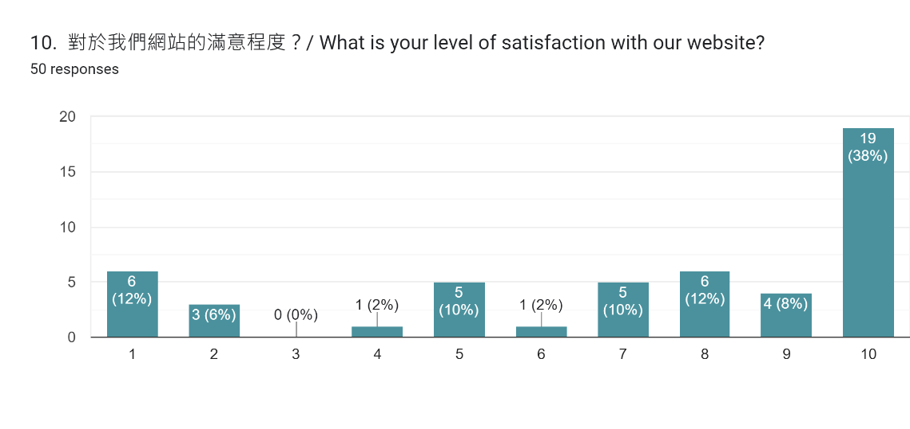
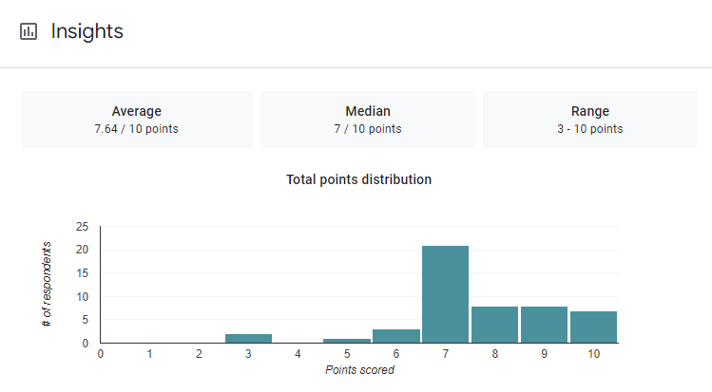
After completing the Project…
3. Outcome of the Project
Are the expected outcomes achieved? Please give evidence to explain.
(e.g. Questionnaire result, feedback from participants/community, etc.)
Link of the online questionnaire (if any): https://forms.gle/cuXPz9wj7F32eAXQ6
Expected Outcome 1: Increase teenagers’ awareness on cybersecurity
Feedback from participants / community:
Questionnaire result:
Notes:
3. Outcome of the Project 項目的成果
Are the expected outcomes achieved? Please give evidence(s) to explain.
項目的預計成果有達成嗎? 請提供證據以作解說。
(e.g. Questionnaire result, feedback from participants/community, etc.)
(e.g., 問卷調查結果, 參與者 / 社群的意見回饋, 等等。)
Link of the online questionnaire (if any): 網上問卷的網址 (如有):
Expected Outcome 1: 預期成效一:
E.g. Feedback from participants / community:
E.g.,參與者 / 社群的意見回饋:
E.g. Questionnaire result:
E.g.,問卷調查結果:

Slide 35
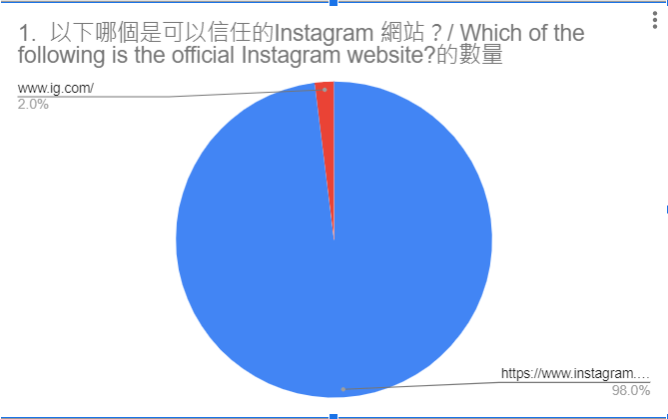
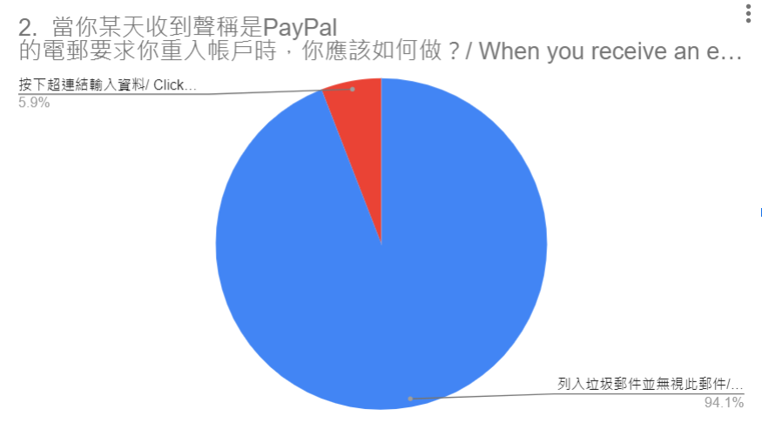
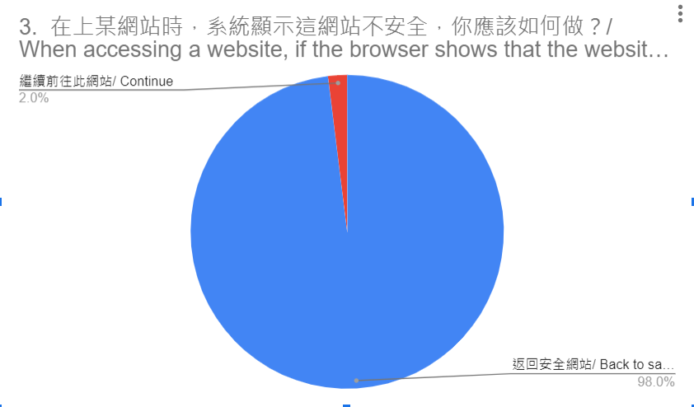
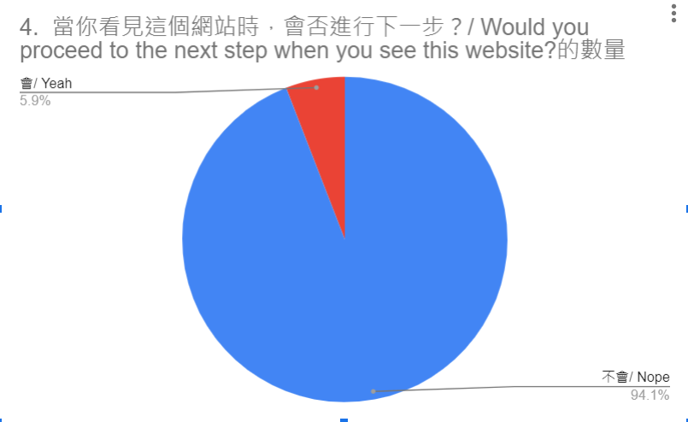
Questionnaire result:
Questionnaire result:
Questionnaire result:
Questionnaire result:
***Question 1-4, blue color is the correct answer***

Slide 36
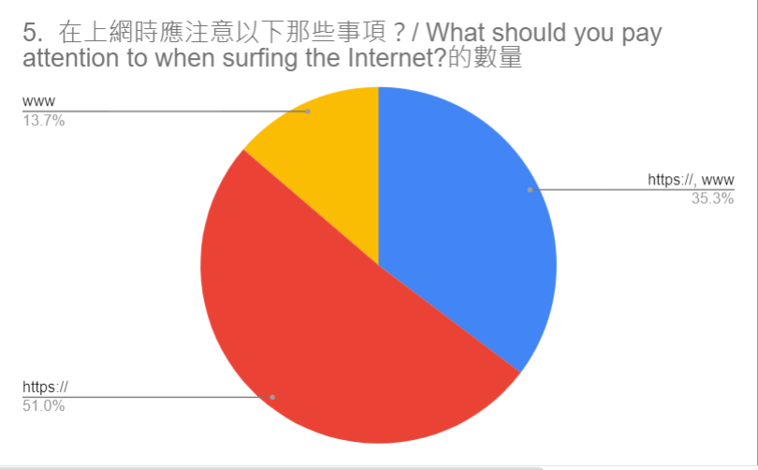
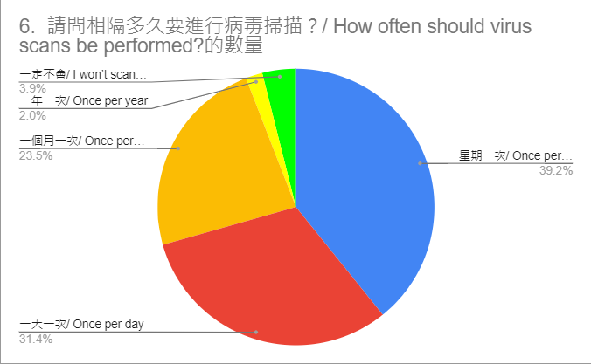
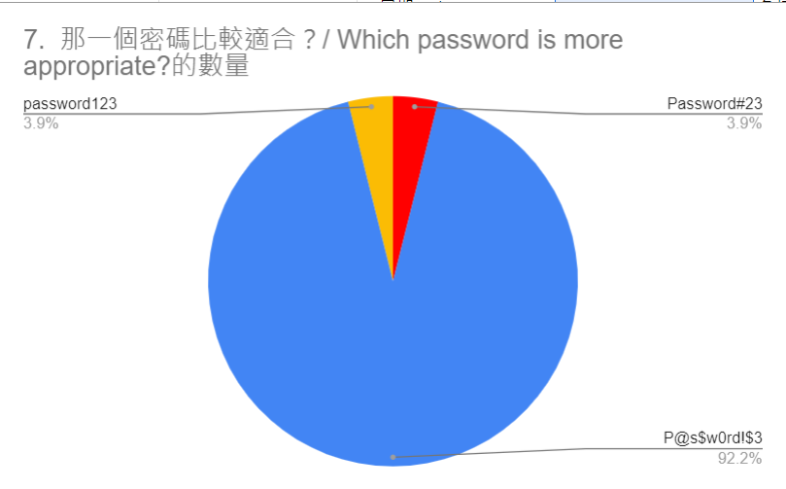
Questionnaire result:
Questionnaire result:
Questionnaire result:
***Question 5 and 7, blue is the correct answer, question 6 is all correct answer except yellow and green***

Slide 37
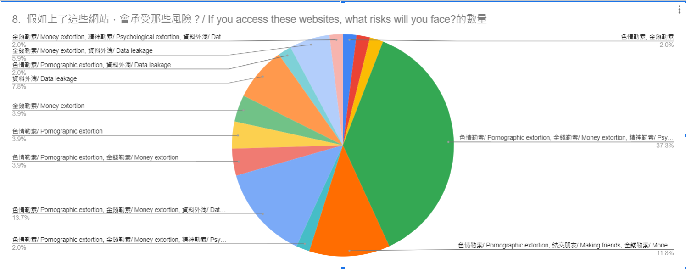
Questionnaire result:

Slide 38
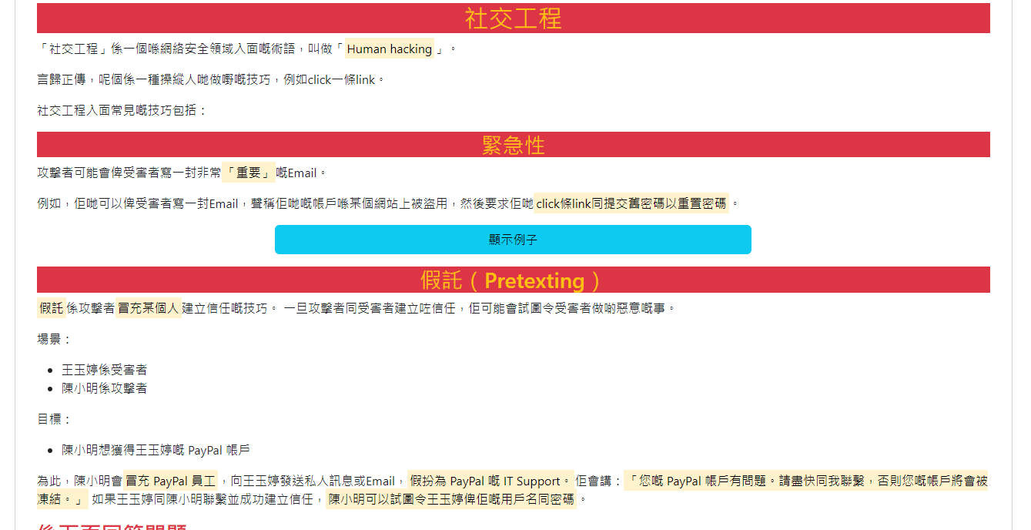
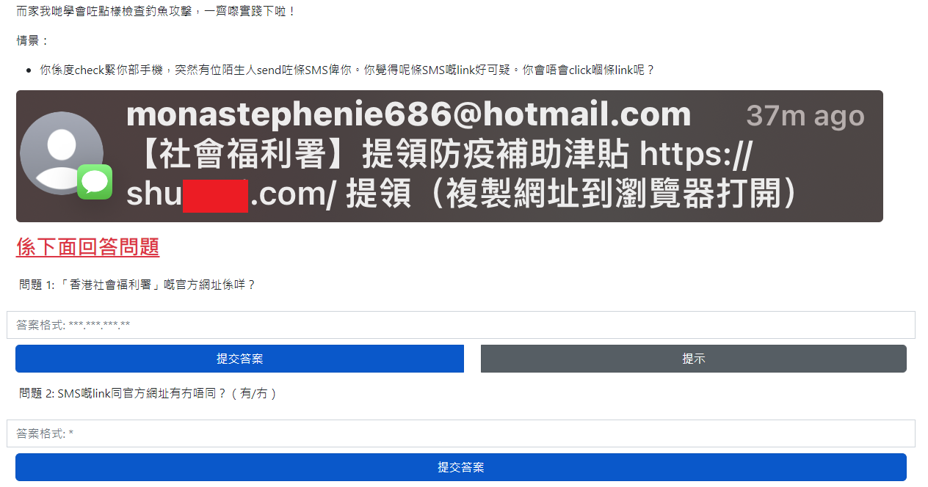
After completing the Project…
3. Outcome of the Project
Are the expected outcomes achieved? Please give evidence to explain.
(e.g. Questionnaire result, feedback from target group/community, etc.)
Expected Outcome 2: Expand cybersecurity knowledge
Website content:
Website questions:
Notes:
3. Outcome of the Project 項目的成果
Are the expected outcomes achieved? Please give evidence(s) to explain.
項目的預計成果有達成嗎? 請提供證據以作解說。
(e.g. Questionnaire result, feedback from participants/community, etc.)
(e.g., 問卷調查結果, 參與者 / 社群的意見回饋, 等等。)
Expected Outcome 2: 預期成效二:
E.g. Feedback from participants / community:
E.g. 參與者 / 社群的意見回饋:
E.g. Questionnaire result:
E.g. 問卷調查結果:

Slide 39
4. Please write down your group’s final division of work(最終分工) in this project:
Date | Time | Task | Venue / Platform | Responsible Member(s) | Resources needed (if any)
9/2/2023 - 27/3/2023 | 46 days | Website design & implementation Frontend / Backend Workflow Management | InfinityFree web hosting platform | Tang Cheuk Hei | N/A
9/2/2023 - 27/2/2023 | 2 weeks | PowerPoint Design / workflow management Presentation workflow management Prototype UI/UX Design Storyboard UI/UX Study | Figma Adobe XD Notion | Mercado John Kenneth De Leon Hung Yat Shan Tang Cheuk Hei | N/A
9/2/2023 - 2/3/2023 | 1 Month | Digital Questionnaire Data analyst Data Collection Data Study Final Data Study | Google | Dong Siu Him Ng Wing Yin Ko Chun Kit | N/A
Notes:
請寫出group project最終分工:
Date (日期)
Task (任務)
Responsible Member(負責的組員全名)

Slide 40
5.1 How was your group’s overall performance in terms of the following collaboration skill(s)?
(Students please reference from the radar graph in step 2, and compare the mid-term and overall performance for marking. Please edit the radar graph below to show your group’s performance. )
Notes:
Please right click the graph → Edit Information → Edit Information in Excel → Enter your Team Mark in the Excel table
右click此圖 → 編輯資料 → 在Excel中編輯資料 → 於Excel表輸入你們團隊表現的分數(Team mark)
5. Overall Team Performance 團隊的整體表現
5.1 How was your group’s overall performance in terms of the following collaboration skill(s)?
就與人合作技巧而言, 你小組的整體表現如何?
(Please edit the radar graph below to show your group’s performance)
(請編輯此雷達圖以展示你小組的表現)
Distribution of Work (e.g., Tasks evenly distributed? Distributed according to member’s team roles?)
工作分配安排 (各項工作平均分配? 工作分配是根據各人的團隊角色?)
Communication (e.g., With progress? Mutual understanding? Gave constructive feedback? Active listening?)
溝通 (e.g., 溝通帶來進展? 達致互助明白? 組員有給予有建設性的意見? 有準確聆聽?)
Commitment to the Project? (e.g., Extra meetings? Out of lesson time to do this project?)
對項目投入? (e.g., 有開額外的會議以處理預計之外的事情? 有否以課堂以外的時間處理項目?)
Supporting Others (e.g., Offered help to teammates? Comforted teammates?)
互相支持 (e.g., 幫助組員? 慰問組員?)
Conflict Resolution (e.g., Agreed on something after conflicts?) (pls input NA if no conflict)
衝突處理 (e.g., 衝突後有了共同同意的做法?) (如整個項目過程中沒衝突, 請輸入 NA <i.e., Not Available 不適用> )
Other area: ____________ (pls input NA if no other area)
其他範疇: ______________(如沒有, 請輸入 NA)

Slide 41
5.2 According to the radar graph, please give detailed example(s) throughout the project (including preparation) to evaluate your group’s overall performance.
(Students are recommended reference from the radar graph in step 2 (slide 13) and compare the mid-term and overall performance.)
Distribution of Work:
Our work distribution overall is rated at 6 marks. It’s because most of our works are distributed via WhatsApp group. However, there’s only the team leader distributing project work. It’ll be great if others do the same thing.
Communication:
Our communication overall is rated at 7 marks. Once again, the majority of our works are distributed via WhatsApp, just like the communication. It’ll be wonderful if we discuss the project details in a clearer way, so that less conflict between group members may be increased.
Commitment to the Project:
Our commitment to the project overall is rated at 6 marks. It’s because our teammates are willing to spend their time to complete the project.
Supporting Others:
Our supporting others overall is rated at 7 marks. It’s rated for 7 marks is because when we’re banging against the wall for a problem we’ve encountered during the project, we’ll aid each other, thus solving the problem.
Conflict Resolution:
Our conflict resolution overall is rated at 6 marks. During the process of creating the Google Form, we’ve come across a miscommunication issue that causes conflict between group members. To address this problem, we let those members sink in and fully understand the current situation.
Notes:
5.2 According to the radar graph, please give detailed example(s) throughout the project (including preparation) to evaluate your group’s overall performance.
根據你小組的雷達圖, 請以項目整個過程中 (包括準備工作) 的詳細例子檢討你小組的整體表現
Student are expected to explain the improvement actions/ changes by compare the performance during mid-term of project implementation and the final stage of project & EA presentation
E.g.: In mid term evaluation, students rate a low mark in commitment of project and communication process. After CA2 (team evaluation), they adopt new communicate methods & platform to share ideas, and setup task list & timeline to finish projects. Their efficiency and communication improved. Everyone know their responsibilities and finish on time. The improvement lead to a higher rating in the overall performance. The process of improvement can be used as an examples in 5.2.

Slide 42


Slide 43
SDD4006/SDD4006M Project Presentation
Programme Code/Class: IT114122/1C
Programme Title: Higher Diploma in Cybersecurity
Group No. 3
Project Topic: How young people can learn from cyberattacks and develop good practices in cybersecurity
Tang Cheuk Hei/ 220006482

Slide 44
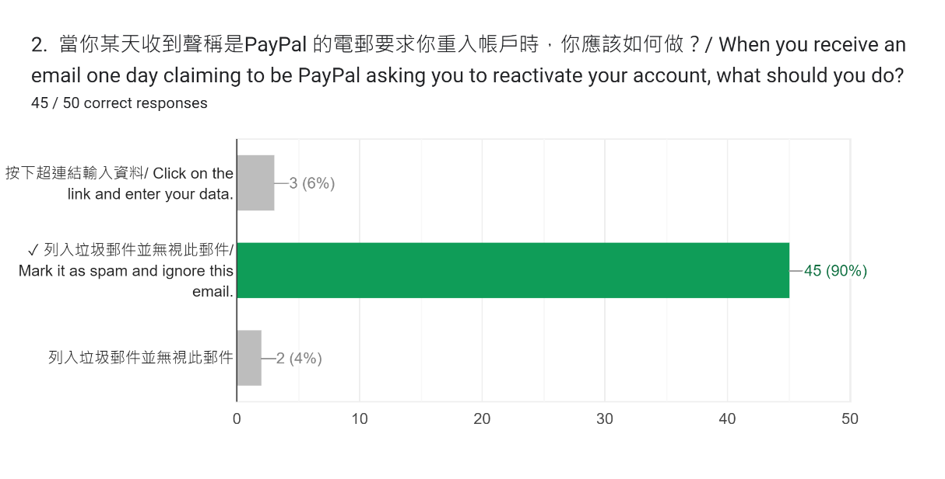
After completing the Project…
6. Self-reflection on social awareness (5%)
6.1 What is your new insight on the community problem / SDG after studying the selected topic and after completion of the project?
Overall, our community has a greater awareness of cybersecurity and phishing attacks.
6.2 From which piece of information / outcome of the project that you have the above new insight?
Notes:
6. Self-reflection on social awareness 自己對社會意識的反思(5%)
6.1 What is your new insight on the community problem / SDG after studying the selected topic and after completion of the project?
在學習你所揀選的題目和完成了此項目之後, 你對於有關的社區問題 / SDG (可持續發展目標) 有何啟發 (i.e.新的看法)?
6.2 From which piece of information / outcome of the project that you have the above new insight?
從項目中的什麼資料/ 成果 (例如問卷調查結果) 令你有以上啟發?

Slide 45
7.1 How was your own performance in terms of collaboration skill(s)? (Please use the radar graph below to show your own performance and answer questions in next two slides)
Notes:
Please right click the graph → Edit Information → Edit Information in Excel → Enter your Mark in the Excel table
右click此圖 → 編輯資料 → 在Excel中編輯資料 → 於Excel表輸入你的表現分數(My mark)
7. Individual Performance 個人表現
7.1 How was your own performance in terms of collaboration skill(s)? (Please use the radar graph below to show your own performance and answer questions in next two slides) 就與人合作技巧而言, 你表現如何? (請以此雷達圖展示你的個人表現以及於下兩頁 PPT 作答問題)
Organization skill (e.g. able to delegate workload, take care of their responsibilities, and keep themselves organized)
組織能力(e.g., 委派工作、了解每位成員職責、及確保每位成員都可以有條理地安排工作，以達成目標)
Communication (e.g., Gave constructive feedback? Active listening?)
溝通 (e.g., 有給予有建設性的意見? 有準確聆聽?)
Commitment to the Project? (e.g., Extra meeting to do this project?)
對項目投入? (e.g., 有開額外的會議以處理預計之外的事情?)
Supporting Others (e.g., Offered help to teammates? Comforted teammates?)
互相支持 (e.g., 幫助組員? 慰問組員?)
Conflict Resolution (e.g., Offered solutions to conflicts?) (pls input NA if no conflict)
衝突處理 (e.g., 就衝突提供了解決方法?) (如整個項目過程中沒衝突, 請輸入 NA <i.e., Not Available 不適用> )
Other area: ____________ (pls input NA if no other area)
其他範疇: ______________(如沒有, 請輸入 NA)

Slide 46
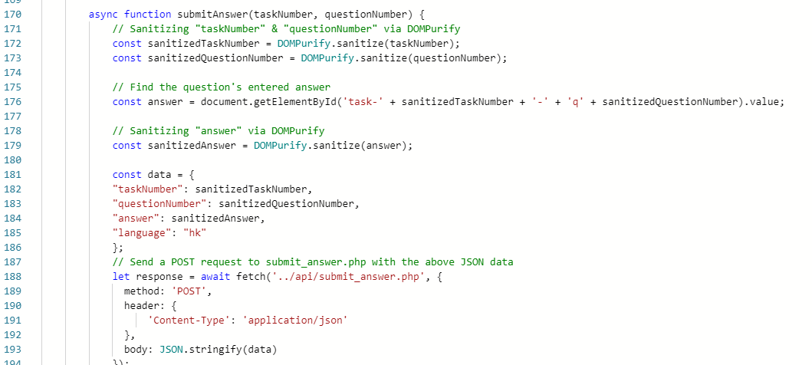
After completing the Project…
7. Individual Performance
7.2 Identify your own strength in the radar graph and explain with a detailed example throughout the project. (5%)
Commitment to the Project:
Throughout the project, I spent around 7 weeks to complete the website, including its contents, and 1 week on the Google Form questionnaire. With that said, I’m good at the technical side of things, which allows me to leverage my expertise to finalize the project.
Notes:
7. Individual Performance 個人表現
7.2 Identify your own strength in the radar graph and explain with a detailed example throughout the project. (5%)
在雷達圖中展示出你的強項, 並以項目過程中一個詳細的例子說明你的強項。

Slide 47
After completing the Project…
7. Individual Performance
7.3 Identify your own weakness in the radar graph and explain with a detailed example throughout the project. (5%)
Organization skill:
As a team leader, although I was able to delegate workload to other members, I still failed to take care of members’ responsibilities and keep members organized. For instance, I was way too focused on the web development that I took over others’ workloads, like the contents of the website, which should be done by other team members.
Notes:
7. Individual Performance 個人表現
7.3 Identify your own weakness in the radar graph and explain with a detailed example throughout the project. (5%)
在雷達圖中展示出你的弱項, 並以項目過程中一個詳細的例子說明你的弱項。

Slide 48
SDD4006/SDD4006M Project Presentation
Programme Code/Class: IT114122/1C
Programme Title: Higher Diploma in Cybersecurity
Group No. 3
Project Topic: How young people can learn from cyberattacks and develop good practices in cybersecurity
Dong Siu Him/ 223071854

Slide 49
After completing the Project…
6. Self-reflection on social awareness (5%)
6.1 What is your new insight on the community problem / SDG after studying the selected topic and after completion of the project?
According to the research, I found that most interviewees will pay attention to whether the website is correct before entering the website. Therefore, I believe that people will avoid phishing websites and reduce the risk of being scammed.
Notes:
6. Self-reflection on social awareness 自己對社會意識的反思(5%)
6.1 What is your new insight on the community problem / SDG after studying the selected topic and after completion of the project?
在學習你所揀選的題目和完成了此項目之後, 你對於有關的社區問題 / SDG (可持續發展目標) 有何啟發 (i.e.新的看法)?
6.2 From which piece of information / outcome of the project that you have the above new insight?
從項目中的什麼資料/ 成果 (例如問卷調查結果) 令你有以上啟發?

Slide 50
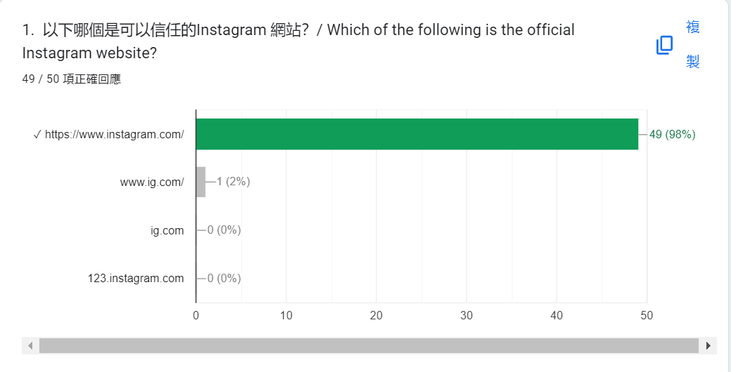
6.2 From which piece of information / outcome of the project that you have the above new insight?

Slide 51
7.1 How was your own performance in terms of collaboration skill(s)? (Please use the radar graph below to show your own performance and answer questions in next two slides)
Notes:
Please right click the graph → Edit Information → Edit Information in Excel → Enter your Mark in the Excel table
右click此圖 → 編輯資料 → 在Excel中編輯資料 → 於Excel表輸入你的表現分數(My mark)
7. Individual Performance 個人表現
7.1 How was your own performance in terms of collaboration skill(s)? (Please use the radar graph below to show your own performance and answer questions in next two slides) 就與人合作技巧而言, 你表現如何? (請以此雷達圖展示你的個人表現以及於下兩頁 PPT 作答問題)
Organization skill (e.g. able to delegate workload, take care of their responsibilities, and keep themselves organized)
組織能力(e.g., 委派工作、了解每位成員職責、及確保每位成員都可以有條理地安排工作，以達成目標)
Communication (e.g., Gave constructive feedback? Active listening?)
溝通 (e.g., 有給予有建設性的意見? 有準確聆聽?)
Commitment to the Project? (e.g., Extra meeting to do this project?)
對項目投入? (e.g., 有開額外的會議以處理預計之外的事情?)
Supporting Others (e.g., Offered help to teammates? Comforted teammates?)
互相支持 (e.g., 幫助組員? 慰問組員?)
Conflict Resolution (e.g., Offered solutions to conflicts?) (pls input NA if no conflict)
衝突處理 (e.g., 就衝突提供了解決方法?) (如整個項目過程中沒衝突, 請輸入 NA <i.e., Not Available 不適用> )
Other area: ____________ (pls input NA if no other area)
其他範疇: ______________(如沒有, 請輸入 NA)

Slide 52
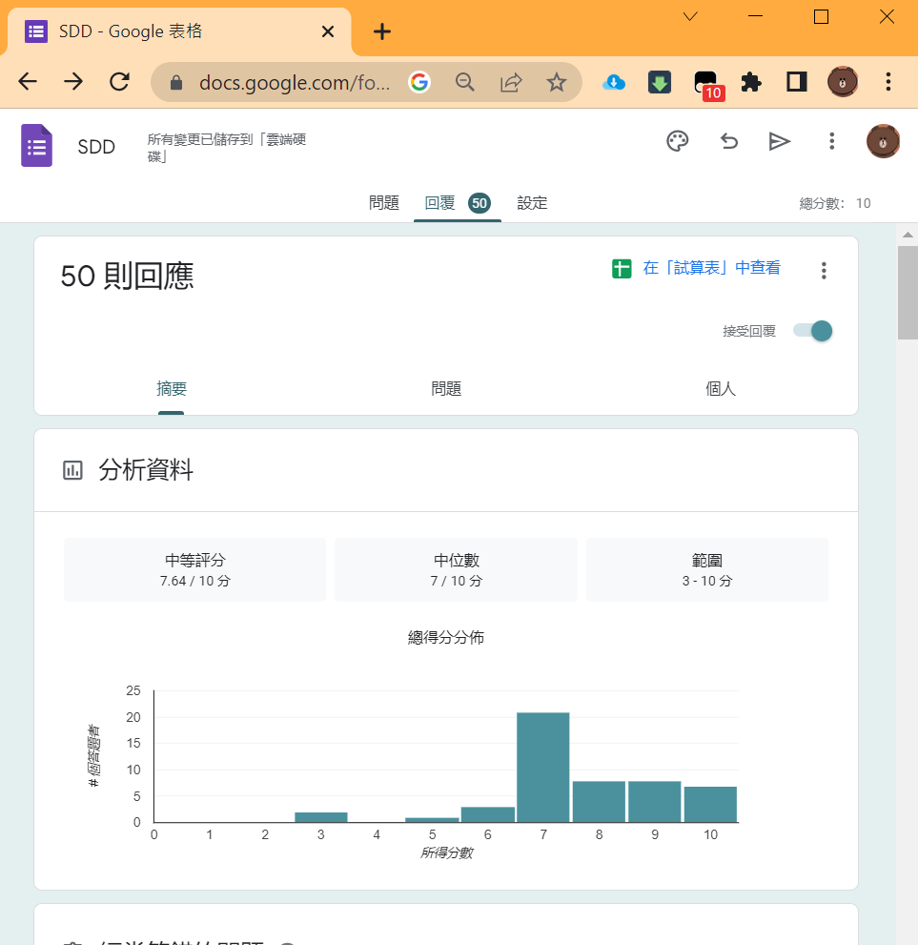
After completing the Project…
7. Individual Performance
7.2 Identify your own strength in the radar graph and explain with a detailed example throughout the project. (5%)
-Commitment to the project
Since I am not good at designing websites, I can’t finish designing our websites by myself. However, I do my best to design our Google form. I design ten questions to ask the interviewees about their knowledges of phishing webs and the main content revolves around our life examples because I think just talking about phishing sites is boring. I teach respondents about phishing websites with real-life examples so that they can get their attention to learn.
Notes:
7. Individual Performance 個人表現
7.2 Identify your own strength in the radar graph and explain with a detailed example throughout the project. (5%)
在雷達圖中展示出你的強項, 並以項目過程中一個詳細的例子說明你的強項。

Slide 53
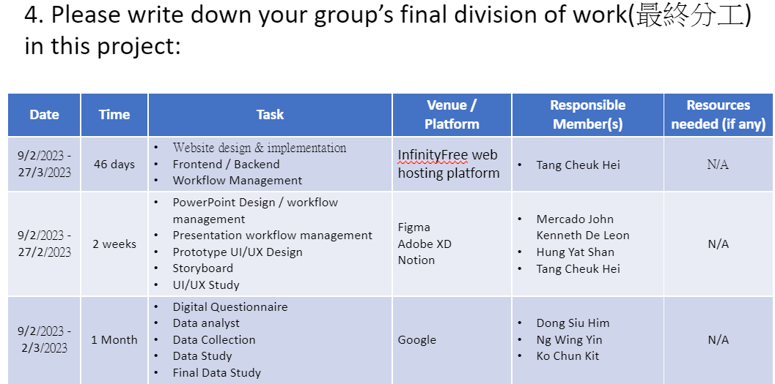
After completing the Project…
7. Individual Performance
7.3 Identify your own weakness in the radar graph and explain with a detailed example throughout the project. (5%)
Communication
To begin with, we distribute different jobs to each other. However, some teammates don’t finish their jobs, especially in the Google form. Therefore, I was reminded to do Google Forms on WhatsApp but I was asked by other teammates what topic to do.
After this things, I find that we do not have any communication for doing our jobs. To solve the problem, we should communicate face-to-face and set a deadline to finish which jobs. Another important thing is that attending every discussion as much as possible, our group members should not think that these subjects are useless and not come back.
PowerPoint page 39
Notes:
7. Individual Performance 個人表現
7.3 Identify your own weakness in the radar graph and explain with a detailed example throughout the project. (5%)
在雷達圖中展示出你的弱項, 並以項目過程中一個詳細的例子說明你的弱項。

Slide 54
SDD4006/SDD4006M Project Presentation
Programme Code/Class: IT114122/1C
Programme Title: Higher Diploma in Cybersecurity
Group No. 3
Project Topic: How young people can learn from cyberattacks and develop good practices in cybersecurity
Ng Wing Yin/ 220018235

Slide 55
After completing the Project…
6. Self-reflection on social awareness (5%)
6.1 What is your new insight on the community problem / SDG after studying the selected topic and after completion of the project?
6.2 From which piece of information / outcome of the project that you have the above new insight?
Notes:
6. Self-reflection on social awareness 自己對社會意識的反思(5%)
6.1 What is your new insight on the community problem / SDG after studying the selected topic and after completion of the project?
在學習你所揀選的題目和完成了此項目之後, 你對於有關的社區問題 / SDG (可持續發展目標) 有何啟發 (i.e.新的看法)?
6.2 From which piece of information / outcome of the project that you have the above new insight?
從項目中的什麼資料/ 成果 (例如問卷調查結果) 令你有以上啟發?

Slide 56
7.1 How was your own performance in terms of collaboration skill(s)? (Please use the radar graph below to show your own performance and answer questions in next two slides)
Notes:
Please right click the graph → Edit Information → Edit Information in Excel → Enter your Mark in the Excel table
右click此圖 → 編輯資料 → 在Excel中編輯資料 → 於Excel表輸入你的表現分數(My mark)
7. Individual Performance 個人表現
7.1 How was your own performance in terms of collaboration skill(s)? (Please use the radar graph below to show your own performance and answer questions in next two slides) 就與人合作技巧而言, 你表現如何? (請以此雷達圖展示你的個人表現以及於下兩頁 PPT 作答問題)
Organization skill (e.g. able to delegate workload, take care of their responsibilities, and keep themselves organized)
組織能力(e.g., 委派工作、了解每位成員職責、及確保每位成員都可以有條理地安排工作，以達成目標)
Communication (e.g., Gave constructive feedback? Active listening?)
溝通 (e.g., 有給予有建設性的意見? 有準確聆聽?)
Commitment to the Project? (e.g., Extra meeting to do this project?)
對項目投入? (e.g., 有開額外的會議以處理預計之外的事情?)
Supporting Others (e.g., Offered help to teammates? Comforted teammates?)
互相支持 (e.g., 幫助組員? 慰問組員?)
Conflict Resolution (e.g., Offered solutions to conflicts?) (pls input NA if no conflict)
衝突處理 (e.g., 就衝突提供了解決方法?) (如整個項目過程中沒衝突, 請輸入 NA <i.e., Not Available 不適用> )
Other area: ____________ (pls input NA if no other area)
其他範疇: ______________(如沒有, 請輸入 NA)

Slide 57
After completing the Project…
7. Individual Performance
7.2 Identify your own strength in the radar graph and explain with a detailed example throughout the project. (5%)
Notes:
7. Individual Performance 個人表現
7.2 Identify your own strength in the radar graph and explain with a detailed example throughout the project. (5%)
在雷達圖中展示出你的強項, 並以項目過程中一個詳細的例子說明你的強項。

Slide 58
After completing the Project…
7. Individual Performance
7.3 Identify your own weakness in the radar graph and explain with a detailed example throughout the project. (5%)
Notes:
7. Individual Performance 個人表現
7.3 Identify your own weakness in the radar graph and explain with a detailed example throughout the project. (5%)
在雷達圖中展示出你的弱項, 並以項目過程中一個詳細的例子說明你的弱項。

Slide 59
SDD4006/SDD4006M Project Presentation
Programme Code/Class: IT114122/1C
Programme Title: Higher Diploma in Cybersecurity
Group No.3
Project Topic: How young people can learn from cyberattacks and develop good practices in cybersecurity
Ko Chun Kit/ 220111510

Slide 60
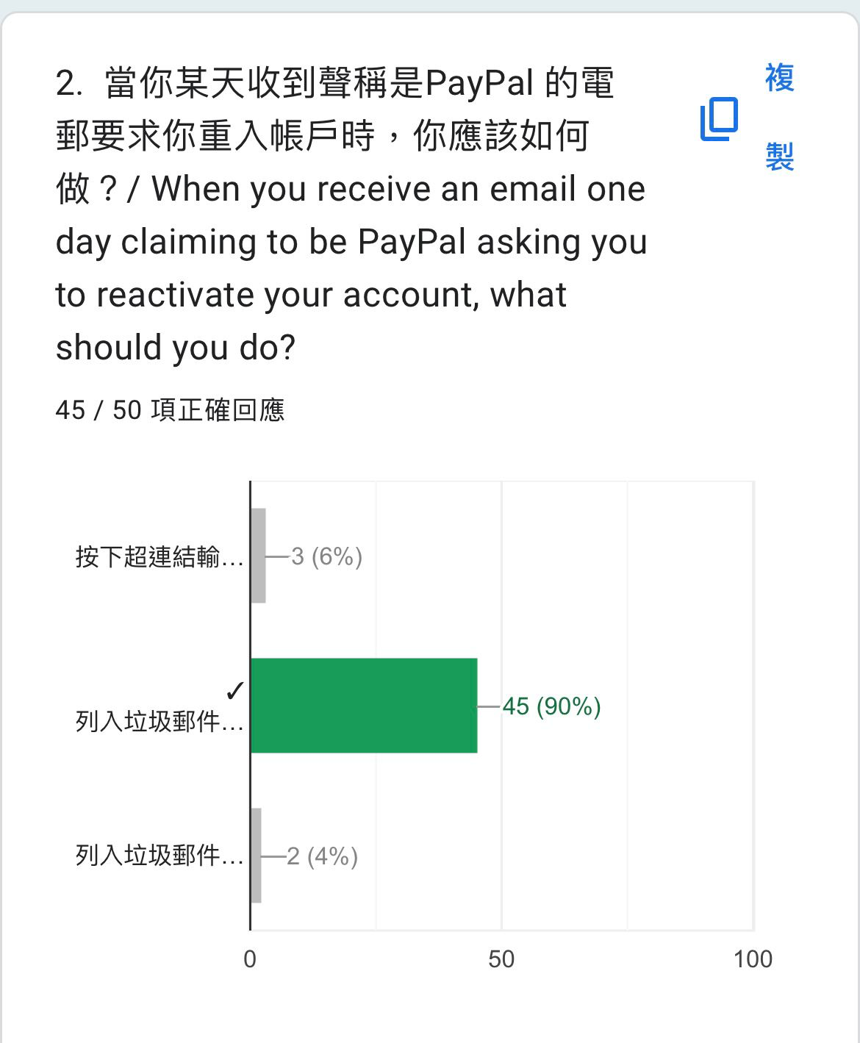
After completing the Project…
6. Self-reflection on social awareness (5%)
6.1 What is your new insight on the community problem / SDG after studying the selected topic and after completion of the project?
Based on our survey, people already have a general awareness of phishing websites.
6.2 From which piece of information / outcome of the project that you have the above new insight?
Notes:
6. Self-reflection on social awareness 自己對社會意識的反思(5%)
6.1 What is your new insight on the community problem / SDG after studying the selected topic and after completion of the project?
在學習你所揀選的題目和完成了此項目之後, 你對於有關的社區問題 / SDG (可持續發展目標) 有何啟發 (i.e.新的看法)?
6.2 From which piece of information / outcome of the project that you have the above new insight?
從項目中的什麼資料/ 成果 (例如問卷調查結果) 令你有以上啟發?

Slide 61
7.1 How was your own performance in terms of collaboration skill(s)? (Please use the radar graph below to show your own performance and answer questions in next two slides)
Notes:
Please right click the graph → Edit Information → Edit Information in Excel → Enter your Mark in the Excel table
右click此圖 → 編輯資料 → 在Excel中編輯資料 → 於Excel表輸入你的表現分數(My mark)
7. Individual Performance 個人表現
7.1 How was your own performance in terms of collaboration skill(s)? (Please use the radar graph below to show your own performance and answer questions in next two slides) 就與人合作技巧而言, 你表現如何? (請以此雷達圖展示你的個人表現以及於下兩頁 PPT 作答問題)
Organization skill (e.g. able to delegate workload, take care of their responsibilities, and keep themselves organized)
組織能力(e.g., 委派工作、了解每位成員職責、及確保每位成員都可以有條理地安排工作，以達成目標)
Communication (e.g., Gave constructive feedback? Active listening?)
溝通 (e.g., 有給予有建設性的意見? 有準確聆聽?)
Commitment to the Project? (e.g., Extra meeting to do this project?)
對項目投入? (e.g., 有開額外的會議以處理預計之外的事情?)
Supporting Others (e.g., Offered help to teammates? Comforted teammates?)
互相支持 (e.g., 幫助組員? 慰問組員?)
Conflict Resolution (e.g., Offered solutions to conflicts?) (pls input NA if no conflict)
衝突處理 (e.g., 就衝突提供了解決方法?) (如整個項目過程中沒衝突, 請輸入 NA <i.e., Not Available 不適用> )
Other area: ____________ (pls input NA if no other area)
其他範疇: ______________(如沒有, 請輸入 NA)

Slide 62
After completing the Project…
7. Individual Performance
7.2 Identify your own strength in the radar graph and explain with a detailed example throughout the project. (5%)
My strength in the radar graph was supporting others. When working on the fishing website form, if a team member was unsure how to raise a question, I would provide them with effective opinions and suggestions to help them overcome difficulties and challenges, promoting efficiency and progress in form-making
Notes:
7. Individual Performance 個人表現
7.2 Identify your own strength in the radar graph and explain with a detailed example throughout the project. (5%)
在雷達圖中展示出你的強項, 並以項目過程中一個詳細的例子說明你的強項。

Slide 63
After completing the Project…
7. Individual Performance
7.3 Identify your own weakness in the radar graph and explain with a detailed example throughout the project. (5%)
My weakness in the radar graph was communication. Throughout the project, I had less communication with my team members, resulting in not knowing which team member was responsible for which task, causing some problems with task division.
Notes:
7. Individual Performance 個人表現
7.3 Identify your own weakness in the radar graph and explain with a detailed example throughout the project. (5%)
在雷達圖中展示出你的弱項, 並以項目過程中一個詳細的例子說明你的弱項。

Slide 64
SDD4006/SDD4006M Project Presentation
Programme Code/Class: IT114122/1C
Programme Title: Higher Diploma in Cybersecurity
Group No. 3
Project Topic: How young people can learn from cyberattacks and develop good practices in cybersecurity
Hung Yat Shan/ 220220462

Slide 65
After completing the Project…
6. Self-reflection on social awareness (5%)
6.1 What is your new insight on the community problem / SDG after studying the selected topic and after completion of the project?
I think people's awareness of cyber security is still insufficient and their awareness can be strengthened
6.2 From which piece of information / outcome of the project that you have the above new insight?
People generally can't quite answer our questions correctly
Notes:
6. Self-reflection on social awareness 自己對社會意識的反思(5%)
6.1 What is your new insight on the community problem / SDG after studying the selected topic and after completion of the project?
在學習你所揀選的題目和完成了此項目之後, 你對於有關的社區問題 / SDG (可持續發展目標) 有何啟發 (i.e.新的看法)?
6.2 From which piece of information / outcome of the project that you have the above new insight?
從項目中的什麼資料/ 成果 (例如問卷調查結果) 令你有以上啟發?

Slide 66
7.1 How was your own performance in terms of collaboration skill(s)? (Please use the radar graph below to show your own performance and answer questions in next two slides)
Notes:
Please right click the graph → Edit Information → Edit Information in Excel → Enter your Mark in the Excel table
右click此圖 → 編輯資料 → 在Excel中編輯資料 → 於Excel表輸入你的表現分數(My mark)
7. Individual Performance 個人表現
7.1 How was your own performance in terms of collaboration skill(s)? (Please use the radar graph below to show your own performance and answer questions in next two slides) 就與人合作技巧而言, 你表現如何? (請以此雷達圖展示你的個人表現以及於下兩頁 PPT 作答問題)
Organization skill (e.g. able to delegate workload, take care of their responsibilities, and keep themselves organized)
組織能力(e.g., 委派工作、了解每位成員職責、及確保每位成員都可以有條理地安排工作，以達成目標)
Communication (e.g., Gave constructive feedback? Active listening?)
溝通 (e.g., 有給予有建設性的意見? 有準確聆聽?)
Commitment to the Project? (e.g., Extra meeting to do this project?)
對項目投入? (e.g., 有開額外的會議以處理預計之外的事情?)
Supporting Others (e.g., Offered help to teammates? Comforted teammates?)
互相支持 (e.g., 幫助組員? 慰問組員?)
Conflict Resolution (e.g., Offered solutions to conflicts?) (pls input NA if no conflict)
衝突處理 (e.g., 就衝突提供了解決方法?) (如整個項目過程中沒衝突, 請輸入 NA <i.e., Not Available 不適用> )
Other area: ____________ (pls input NA if no other area)
其他範疇: ______________(如沒有, 請輸入 NA)

Slide 67
After completing the Project…
7. Individual Performance
7.2 Identify your own strength in the radar graph and explain with a detailed example throughout the project. (5%)
I think communication is my strong point. Many times I try to understand what the team thinks and express it for them.
Notes:
7. Individual Performance 個人表現
7.2 Identify your own strength in the radar graph and explain with a detailed example throughout the project. (5%)
在雷達圖中展示出你的強項, 並以項目過程中一個詳細的例子說明你的強項。

Slide 68
After completing the Project…
7. Individual Performance
7.3 Identify your own weakness in the radar graph and explain with a detailed example throughout the project. (5%)
I think my weakness is the commitment to the project ,many times I need the leader to assign work to me.
Notes:
7. Individual Performance 個人表現
7.3 Identify your own weakness in the radar graph and explain with a detailed example throughout the project. (5%)
在雷達圖中展示出你的弱項, 並以項目過程中一個詳細的例子說明你的弱項。

Slide 69
SDD4006/SDD4006M Project Presentation
Programme Code/Class: IT114122/1C
Programme Title: Higher Diploma in Cybersecurity
Group No. 3
Project Topic: How young people can learn from cyberattacks and develop good practices in cybersecurity
Mercado J.k De Leon/ 220017982

Slide 70
After completing the Project…
6. Self-reflection on social awareness (5%)
6.1 What is your new insight on the community problem / SDG after studying the selected topic and after completion of the project?
Having a new view on phising attacking and how the majourity of people does not have the basic understanding of cyber security.
6.2 From which piece of information / outcome of the project that you have the above new insight?
After analyising the graph, i was a shock how this age of information technology and people still don't understand the basics of cyber security.
Notes:
6. Self-reflection on social awareness 自己對社會意識的反思(5%)
6.1 What is your new insight on the community problem / SDG after studying the selected topic and after completion of the project?
在學習你所揀選的題目和完成了此項目之後, 你對於有關的社區問題 / SDG (可持續發展目標) 有何啟發 (i.e.新的看法)?
6.2 From which piece of information / outcome of the project that you have the above new insight?
從項目中的什麼資料/ 成果 (例如問卷調查結果) 令你有以上啟發?

Slide 71
7.1 How was your own performance in terms of collaboration skill(s)? (Please use the radar graph below to show your own performance and answer questions in next two slides)
Notes:
Please right click the graph → Edit Information → Edit Information in Excel → Enter your Mark in the Excel table
右click此圖 → 編輯資料 → 在Excel中編輯資料 → 於Excel表輸入你的表現分數(My mark)
7. Individual Performance 個人表現
7.1 How was your own performance in terms of collaboration skill(s)? (Please use the radar graph below to show your own performance and answer questions in next two slides) 就與人合作技巧而言, 你表現如何? (請以此雷達圖展示你的個人表現以及於下兩頁 PPT 作答問題)
Organization skill (e.g. able to delegate workload, take care of their responsibilities, and keep themselves organized)
組織能力(e.g., 委派工作、了解每位成員職責、及確保每位成員都可以有條理地安排工作，以達成目標)
Communication (e.g., Gave constructive feedback? Active listening?)
溝通 (e.g., 有給予有建設性的意見? 有準確聆聽?)
Commitment to the Project? (e.g., Extra meeting to do this project?)
對項目投入? (e.g., 有開額外的會議以處理預計之外的事情?)
Supporting Others (e.g., Offered help to teammates? Comforted teammates?)
互相支持 (e.g., 幫助組員? 慰問組員?)
Conflict Resolution (e.g., Offered solutions to conflicts?) (pls input NA if no conflict)
衝突處理 (e.g., 就衝突提供了解決方法?) (如整個項目過程中沒衝突, 請輸入 NA <i.e., Not Available 不適用> )
Other area: ____________ (pls input NA if no other area)
其他範疇: ______________(如沒有, 請輸入 NA)

Slide 72
After completing the Project…
7. Individual Performance
7.2 Identify your own strength in the radar graph and explain with a detailed example throughout the project. (5%)
My strength in this whole project was the startup of the project to designing the sketch of the website base on UI/UX of the project. Having the basic understanding of making a website on Figma. Being able to sketch a website just based on modern website design and functionality.
Notes:
7. Individual Performance 個人表現
7.2 Identify your own strength in the radar graph and explain with a detailed example throughout the project. (5%)
在雷達圖中展示出你的強項, 並以項目過程中一個詳細的例子說明你的強項。

Slide 73
After completing the Project…
7. Individual Performance
7.3 Identify your own weakness in the radar graph and explain with a detailed example throughout the project. (5%)
My weakness in this whole project and it could be seen on the radar graph I was basically absent in communication and supporting others. I didn’t really offered help to the other part of the projects, I just sticked with my design work and once I am done I just shut myself off to others. Same thing in communications, didn’t really talk to most of my teammates since I was too busy with personal issues.
Notes:
7. Individual Performance 個人表現
7.3 Identify your own weakness in the radar graph and explain with a detailed example throughout the project. (5%)
在雷達圖中展示出你的弱項, 並以項目過程中一個詳細的例子說明你的弱項。

